Slide 1
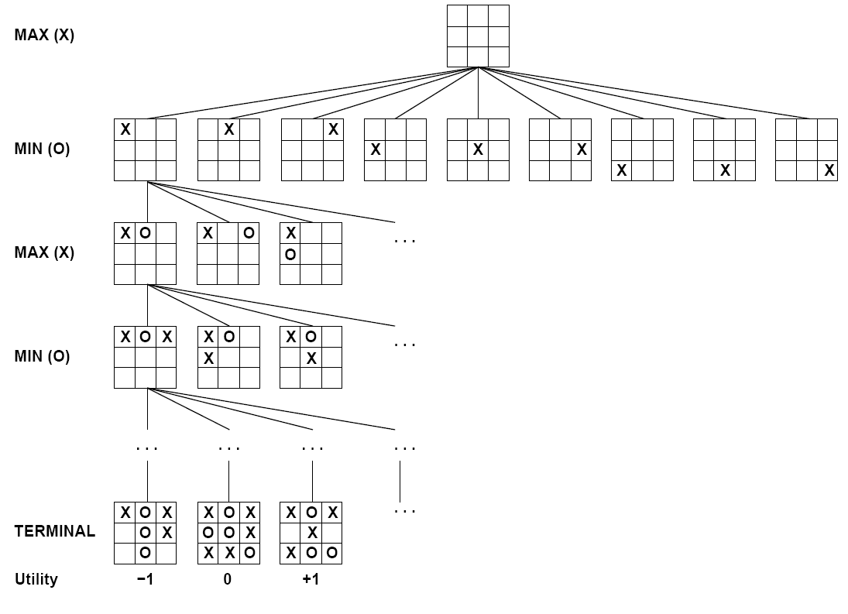
Warm Up
How would you search for moves in Tic Tac Toe?

Slide 2

AI: Representation and Problem Solving
Adversarial Search
Instructors: Pat Virtue & Stephanie Rosenthal
Slide credits: Pat Virtue, http://ai.berkeley.edu

Slide 3
Announcements
Homework 2 due tonight!
Homework 3 out this evening!
P1 due 2/7, work in pairs!

Slide 4
Warm Up
How would you search for moves in Tic Tac Toe?

Slide 5
Warm Up
How is Tic Tac Toe different from maze search?

Slide 6
Warm Up
How is Tic Tac Toe different from maze search?
Multi-Agent, Adversarial, Zero Sum
Single Agent

Slide 7
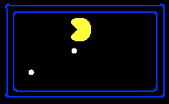
Single-Agent Trees
8
2
0
…
2
6
…
4
6
Notes:
10 points for eating dot; -1 for each time step

Slide 8
Value of a State
Non-Terminal States:
V(s) = max V(s’)
Value of a state: The best achievable outcome (utility) from that state
s’ ∈ successors(s)
8
2
0
…
2
6
…
4
6
Terminal States:
V(s) = known

Slide 9
Multi-Agent Applications
(Football)
Adversarial
Team: Collaborative
Competition: Adversarial
Collaborative Maze Solving

Slide 10
How could we model multi-agent collaborative problems?

Slide 11
How could we model multi-agent problems?
Simplest idea: each agent plans their own actions separately from others.

Slide 12
Many Single-Agent Trees
Choose the best action for each agent independently
Non-Terminal States:
V(s) = max V(s’)
s’ ∈ successors(s)
8
2
0
…
2
6
…
4
6
Notes:
10 points for eating dot; -1 for each time step

Slide 13
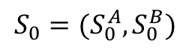
Idea 2: Joint State/Action Spaces
Combine the states and actions of the N agents
$$S_{0}=(S_{0}^{A},S_{0}^{B})$$

Slide 14
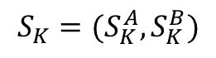
Idea 2: Joint State/Action Spaces
Combine the states and actions of the N agents
$$S_{K}=(S_{K}^{A},S_{K}^{B})$$

Slide 15
Idea 2: Joint State/Action Spaces
Search looks through all combinations of all agents’ states and actions
Think of one brain controlling many agents
$$S_{K}=(S_{K}^{A},S_{K}^{B})$$

Slide 16
Idea 2: Joint State/Action Spaces
Search looks through all combinations of all agents’ states and actions
Think of one brain controlling many agents
What is the size of the state space?
What is the size of the action space?
What is the size of the search tree?

Slide 17
Idea 3: Centralized Decision Making
Each agent proposes their actions and computer confirms the joint plan
Example: Autonomous driving through intersections
https://www.youtube.com/watch?v=4pbAI40dK0A

Slide 18
Idea 4: Alternate Searching One Agent at a Time
Search one agent’s actions from a state, search the next agent’s actions from those resulting states , etc…
Choose the best cascading combination of actions
Non-Terminal States:
V(s) = max V(s’)
Agent 1
s’ ∈ successors(s)
Agent 2
Agent 1

Slide 19
Idea 4: Alternate Searching One Agent at a Time
Search one agent’s actions from a state, search the next agent’s actions from those resulting states , etc…
What is the size of the state space?
What is the size of the action space?
What is the size of the search tree?

Slide 20
Multi-Agent Applications
(Football)
Adversarial
Team: Collaborative
Competition: Adversarial
Collaborative Maze Solving

Slide 21
Games

Slide 22
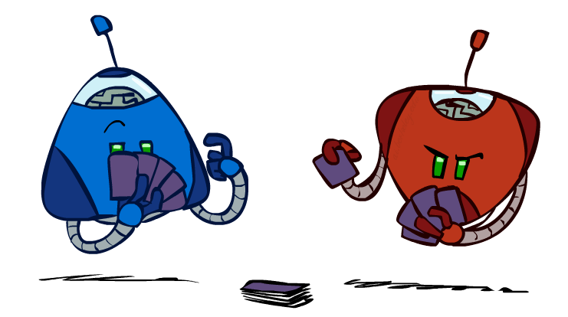
Types of Games
Deterministic or stochastic?
Perfect information (fully observable)?
One, two, or more players?
Turn-taking or simultaneous?
Zero sum?

Slide 23
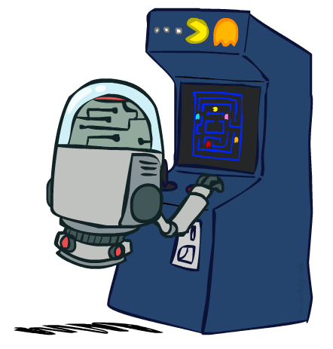
Standard Games
Standard games are deterministic, observable, two-player, turn-taking, zero-sum
Game formulation:
Initial state: s₀
Players: Player(s) indicates whose move it is
Actions: Actions(s) for player on move
Transition model: Result(s,a)
Terminal test: Terminal-Test(s)
Terminal values: Utility(s,p) for player p
Or just Utility(s) for player making the decision at root

Slide 24
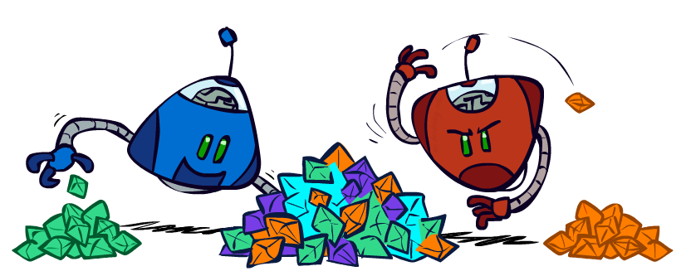
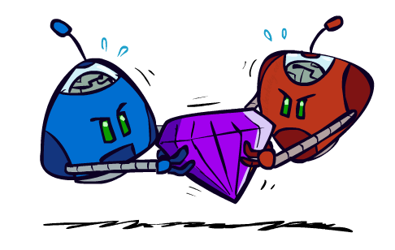
Zero-Sum Games
Zero-Sum Games
Agents have opposite utilities
Pure competition:
One maximizes, the other minimizes
General Games
Agents have independent utilities
Cooperation, indifference, competition, shifting alliances, and more are all possible

Slide 25
Game Trees
Search one agent’s actions from a state, search the competitor’s actions from those resulting states , etc…

Slide 26
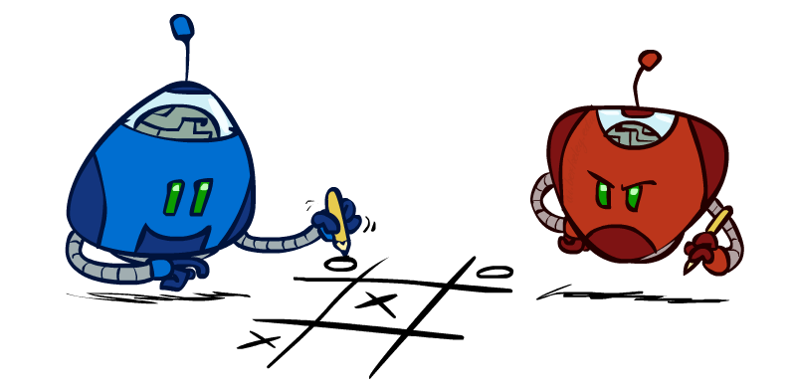
Tic-Tac-Toe Game Tree

Slide 27
Tic-Tac-Toe Game Tree
This is a zero-sum game,
the best action for X is the worst action for O
and vice versa
How do we define best and worst?

Slide 28


Tic-Tac-Toe Game Tree
Instead of taking the max utility at every level, alternate max and min

Slide 29
Tic-Tac-Toe Minimax
MAX nodes: under Agent’s control
V(s) = max V(s’)
s’ ∈ successors(s)
MIN nodes: under Opponent’s control
V(s) = min V(s’)
s’ ∈ successors(s)

Slide 30

Small Pacman Example
MAX nodes: under Agent’s control
V(s) = max V(s’)
MIN nodes: under Opponent’s control
V(s) = min V(s’)
s’ ∈ successors(s)
s’ ∈ successors(s)
-8
-8
-10
-8
-5
-10
+8
Terminal States:
V(s) = known

Slide 31
Minimax Implementation
function minimax-decision(s) returns action
return the action a in Actions(s) with the highest min-value(Result(s,a))
Result(s,a)→s’
function max-value(s) returns value
if Terminal-Test(s) then return Utility(s)
initialize v = -∞
for each a in Actions(s):
v = max(v, min-value(Result(s,a)))
return v
function min-value(s) returns value
if Terminal-Test(s) then return Utility(s)
initialize v = +∞
for each a in Actions(state):
v = min(v, max-value(Result(s,a))
return v
V(s) = max V(s’)
V(s) = min V(s’)
s’ ∈ successors(s)
s’ ∈ successors(s)

Slide 32
Alternative Implementation
function minimax-decision(s) returns an action
return the action a in Actions(s) with the highest value(Result(s,a))
function value(s) returns a value
if Terminal-Test(s) then return Utility(s)
if Player(s) = MAX then return max_{a in Actions(s)} value(Result(s,a))
if Player(s) = MIN then return min_{a in Actions(s)} value(Result(s,a))

Slide 33
Minimax Example
3
3
2
2
3
12
8
2
4
6
14
5
2
Notes:
Add values by hand if on tablet, or add by animation steps

Slide 34
Poll
What kind of search is Minimax Search?
BFS
DFS
UCS
A*

Slide 35
Minimax is Depth-First Search
MAX nodes: under Agent’s control
V(s) = max V(s’)
MIN nodes: under Opponent’s control
V(s) = min V(s’)
s’ ∈ successors(s)
s’ ∈ successors(s)
-8
-8
-10
-8
-5
-10
+8
Terminal States:
V(s) = known

Slide 36

Minimax Efficiency
How efficient is minimax?
Just like (exhaustive) DFS
Time: O(b^{m})
Space: O(bm)
Example: For chess, b ≈ 35, m ≈ 100
Exact solution is completely infeasible
Humans can’t do this either, so how do we play chess?

Slide 37
Small Size Robot Soccer
Joint State/Action space and search for our team
Adversarial search to predict the opponent team
https://www.youtube.com/watch?v=YihJguq26ek

Slide 38



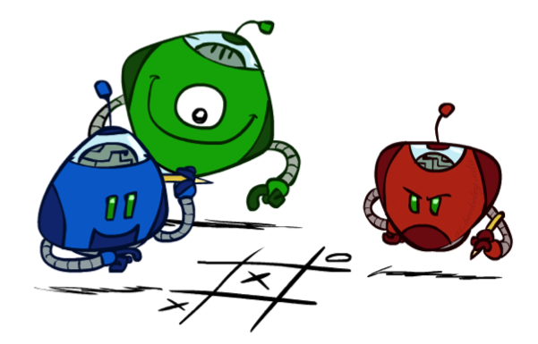
Generalized minimax
What if the game is not zero-sum, or has multiple players?
Generalization of minimax:
Terminals have utility tuples
Node values are also utility tuples
Each player maximizes its own component
Can give rise to cooperation and
competition dynamically…
8,8,1
8,8,1
7,7,2
0,0,7
8,8,1
7,7,2
0,0,8
1,1,6
0,0,7
9,9,0
8,8,1
9,9,0
7,7,2
0,0,8
0,0,7
Notes:
If both ghosts go the same way, pacman wins; if they go different ways, pacman loses

Slide 39
Three Person Chess

Slide 40

Resource Limits

Slide 41
Resource Limits
Problem: In realistic games, cannot search to leaves!
Solution 1: Bounded lookahead
Search only to a preset depth limit or horizon
Use an evaluation function for non-terminal positions
Guarantee of optimal play is gone
More plies make a BIG difference
Example:
Suppose we have 100 seconds, can explore 10K nodes / sec
So can check 1M nodes per move
For chess, b=~35 so reaches about depth 4 – not so good
max
4
-2
4
min
-1
-2
4
9
?
?
?
?

Slide 42
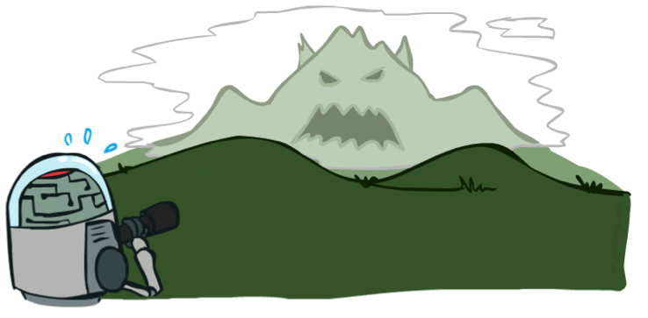

Depth Matters
Evaluation functions are always imperfect
Deeper search => better play (usually)
Or, deeper search gives same quality of play with a less accurate evaluation function
An important example of the tradeoff between complexity of features and complexity of computation
[Demo: depth limited (L6D4, L6D5)]

Slide 43
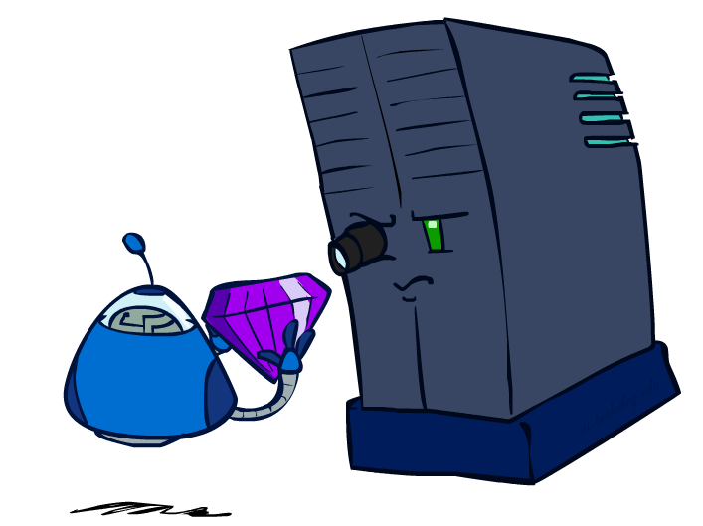
Evaluation Functions

Slide 44
Evaluation Functions
Evaluation functions score non-terminals in depth-limited search
Ideal function: returns the actual minimax value of the position
In practice: typically weighted linear sum of features:
EVAL(s) = w₁ f₁(s) + w₂ f₂(s) + …. + w_{n} f_{n}(s)
E.g., w₁ = 9, f₁(s) = (num white queens – num black queens), etc.
Terminate search only in quiescent positions, i.e., no major
changes expected in feature values

Slide 45
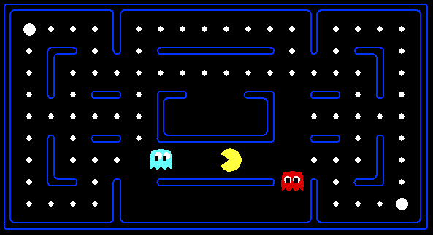

Evaluation for Pacman

Slide 46
Resource Limits
Problem: In realistic games, cannot search to leaves!
Solution 1: Bounded lookahead
Search only to a preset depth limit or horizon
Use an evaluation function for non-terminal positions
Guarantee of optimal play is gone
More plies make a BIG difference
Example:
Suppose we have 100 seconds, can explore 10K nodes / sec
So can check 1M nodes per move
For chess, b=~35 so reaches about depth 4 – not so good
4
max
-2
4
min
-1
-2
4
9
?
?
?
?

Slide 47
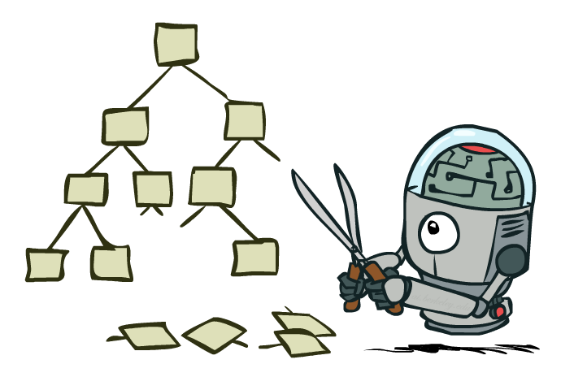
Solution 2: Game Tree Pruning

Slide 48
Intuition: prune the branches that can’t be chosen
3
3
2
2
3
12
8
2
4
6
14
5
2
Notes:
Add values by hand if on tablet, or add by animation steps

Slide 49

Alpha-Beta Pruning Example
α = best option so far from any
MAX node on this path
3
α =3
α =3
3
3
12
8
2
14
5
2
We can prune when: min node won’t be higher than 2, while parent max has seen something larger in another branch
The order of generation matters: more pruning
is possible if good moves come first
Notes:
Add values by hand if on tablet, or add by animation steps

Slide 50
Alpha-Beta Implementation
α: MAX’s best option on path to root
β: MIN’s best option on path to root
def max-value(state, α, β):
initialize v = -∞
for each successor of state:
v = max(v, value(successor, α, β))
if v ≥ β
return v
α = max(α, v)
return v
def min-value(state , α, β):
initialize v = +∞
for each successor of state:
v = min(v, value(successor, α, β))
if v ≤ α
return v
β = min(β, v)
return v
Notes:
Pick an order for two reasons: sequential processor and pruning

Slide 51
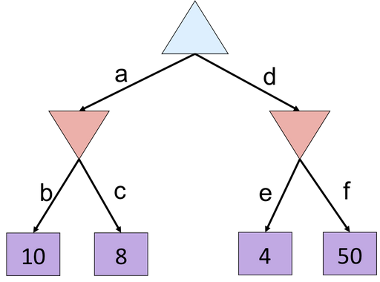
Quiz: Minimax Example
What is the value of the blue triangle?
A) 10
B) 8
C) 4
D) 50
Notes:
f is not evaluated

Slide 52
Quiz: Minimax Example
What is the value of the blue triangle?
A) 10
B) 8
C) 4
D) 50
8
8
4
Notes:
f is not evaluated

Slide 53
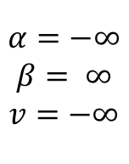
Alpha-Beta Small Example
def max-value(state, α, β):
initialize v = -∞
for each successor of state:
v = max(v, value(successor, α, β))
if v ≥ β
return v
α = max(α, v)
return v
$$α=−∞$$
$$β= ∞$$
$$v=−∞$$
def min-value(state , α, β):
initialize v = +∞
for each successor of state:
v = min(v, value(successor, α, β))
if v ≤ α
return v
β = min(β, v)
return v
Notes:
f is not evaluated

Slide 54
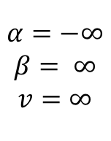
Alpha-Beta Small Example
def max-value(state, α, β):
initialize v = -∞
for each successor of state:
v = max(v, value(successor, α, β))
if v ≥ β
return v
α = max(α, v)
return v
$$α=−∞$$
$$β= ∞$$
$$v=−∞$$
$$α=−∞$$
$$β= ∞$$
$$v=∞$$
def min-value(state , α, β):
initialize v = +∞
for each successor of state:
v = min(v, value(successor, α, β))
if v ≤ α
return v
β = min(β, v)
return v
Notes:
f is not evaluated

Slide 55
Alpha-Beta Small Example
def max-value(state, α, β):
initialize v = -∞
for each successor of state:
v = max(v, value(successor, α, β))
if v ≥ β
return v
α = max(α, v)
return v
$$α=−∞$$
$$β= ∞$$
$$v=−∞$$
$$α=−∞$$
$$β= ∞$$
$$v=∞$$
def min-value(state , α, β):
initialize v = +∞
for each successor of state:
v = min(v, value(successor, α, β))
if v ≤ α
return v
β = min(β, v)
return v
Notes:
f is not evaluated

Slide 56
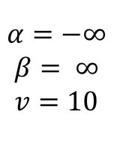
Alpha-Beta Small Example
def max-value(state, α, β):
initialize v = -∞
for each successor of state:
v = max(v, value(successor, α, β))
if v ≥ β
return v
α = max(α, v)
return v
$$α=−∞$$
$$β= ∞$$
$$v=−∞$$
$$α=−∞$$
$$β= ∞$$
$$v=10$$
def min-value(state , α, β):
initialize v = +∞
for each successor of state:
v = min(v, value(successor, α, β))
if v ≤ α
return v
β = min(β, v)
return v
Notes:
f is not evaluated

Slide 57
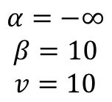
Alpha-Beta Small Example
def max-value(state, α, β):
initialize v = -∞
for each successor of state:
v = max(v, value(successor, α, β))
if v ≥ β
return v
α = max(α, v)
return v
$$α=−∞$$
$$β= ∞$$
$$v=−∞$$
$$α=−∞$$
$$β=10$$
$$v=10$$
def min-value(state , α, β):
initialize v = +∞
for each successor of state:
v = min(v, value(successor, α, β))
if v ≤ α
return v
β = min(β, v)
return v
Notes:
f is not evaluated

Slide 58
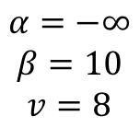
Alpha-Beta Small Example
def max-value(state, α, β):
initialize v = -∞
for each successor of state:
v = max(v, value(successor, α, β))
if v ≥ β
return v
α = max(α, v)
return v
$$α=−∞$$
$$β= ∞$$
$$v=−∞$$
$$α=−∞$$
$$β=10$$
$$v=8$$
def min-value(state , α, β):
initialize v = +∞
for each successor of state:
v = min(v, value(successor, α, β))
if v ≤ α
return v
β = min(β, v)
return v
Notes:
f is not evaluated

Slide 59
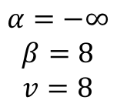
Alpha-Beta Small Example
def max-value(state, α, β):
initialize v = -∞
for each successor of state:
v = max(v, value(successor, α, β))
if v ≥ β
return v
α = max(α, v)
return v
$$α=−∞$$
$$β= ∞$$
$$v=−∞$$
$$α=−∞$$
$$β=8$$
$$v=8$$
def min-value(state , α, β):
initialize v = +∞
for each successor of state:
v = min(v, value(successor, α, β))
if v ≤ α
return v
β = min(β, v)
return v
Notes:
f is not evaluated

Slide 60
Alpha-Beta Small Example
def max-value(state, α, β):
initialize v = -∞
for each successor of state:
v = max(v, value(successor, α, β))
if v ≥ β
return v
α = max(α, v)
return v
$$α=−∞$$
$$β= ∞$$
$$v=−∞$$
$$α=−∞$$
$$β=8$$
$$v=8$$
8
def min-value(state , α, β):
initialize v = +∞
for each successor of state:
v = min(v, value(successor, α, β))
if v ≤ α
return v
β = min(β, v)
return v
Notes:
f is not evaluated

Slide 61
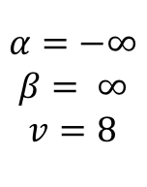
Alpha-Beta Small Example
def max-value(state, α, β):
initialize v = -∞
for each successor of state:
v = max(v, value(successor, α, β))
if v ≥ β
return v
α = max(α, v)
return v
$$α=−∞$$
$$β= ∞$$
$$v=8$$
$$α=−∞$$
$$β=8$$
$$v=8$$
8
def min-value(state , α, β):
initialize v = +∞
for each successor of state:
v = min(v, value(successor, α, β))
if v ≤ α
return v
β = min(β, v)
return v
Notes:
f is not evaluated

Slide 62
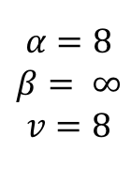
Alpha-Beta Small Example
def max-value(state, α, β):
initialize v = -∞
for each successor of state:
v = max(v, value(successor, α, β))
if v ≥ β
return v
α = max(α, v)
return v
$$α=8$$
$$β= ∞$$
$$v=8$$
$$α=−∞$$
$$β=8$$
$$v=8$$
8
def min-value(state , α, β):
initialize v = +∞
for each successor of state:
v = min(v, value(successor, α, β))
if v ≤ α
return v
β = min(β, v)
return v
Notes:
f is not evaluated

Slide 63
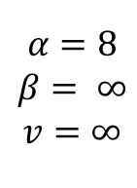
Alpha-Beta Small Example
def max-value(state, α, β):
initialize v = -∞
for each successor of state:
v = max(v, value(successor, α, β))
if v ≥ β
return v
α = max(α, v)
return v
$$α=8$$
$$β= ∞$$
$$v=8$$
$$α=−∞$$
$$β=8$$
$$v=8$$
$$α=8$$
$$β= ∞$$
$$v=∞$$
8
def min-value(state , α, β):
initialize v = +∞
for each successor of state:
v = min(v, value(successor, α, β))
if v ≤ α
return v
β = min(β, v)
return v
Notes:
f is not evaluated

Slide 64
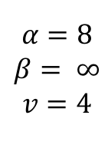
Alpha-Beta Small Example
def max-value(state, α, β):
initialize v = -∞
for each successor of state:
v = max(v, value(successor, α, β))
if v ≥ β
return v
α = max(α, v)
return v
$$α=8$$
$$β= ∞$$
$$v=8$$
$$α=−∞$$
$$β=8$$
$$v=8$$
$$α=8$$
$$β= ∞$$
$$v=4$$
8
def min-value(state , α, β):
initialize v = +∞
for each successor of state:
v = min(v, value(successor, α, β))
if v ≤ α
return v
β = min(β, v)
return v
Notes:
f is not evaluated

Slide 65
Alpha-Beta Small Example
def max-value(state, α, β):
initialize v = -∞
for each successor of state:
v = max(v, value(successor, α, β))
if v ≥ β
return v
α = max(α, v)
return v
$$α=8$$
$$β= ∞$$
$$v=8$$
$$α=−∞$$
$$β=8$$
$$v=8$$
$$α=8$$
$$β= ∞$$
$$v=4$$
8
4
def min-value(state , α, β):
initialize v = +∞
for each successor of state:
v = min(v, value(successor, α, β))
if v ≤ α
return v
β = min(β, v)
return v
Notes:
f is not evaluated

Slide 66
Alpha-Beta Small Example
def max-value(state, α, β):
initialize v = -∞
for each successor of state:
v = max(v, value(successor, α, β))
if v ≥ β
return v
α = max(α, v)
return v
$$α=8$$
$$β= ∞$$
$$v=8$$
$$α=−∞$$
$$β=8$$
$$v=8$$
$$α=8$$
$$β= ∞$$
$$v=4$$
8
4
def min-value(state , α, β):
initialize v = +∞
for each successor of state:
v = min(v, value(successor, α, β))
if v ≤ α
return v
β = min(β, v)
return v
Notes:
f is not evaluated

Slide 67
Alpha-Beta Small Example
def max-value(state, α, β):
initialize v = -∞
for each successor of state:
v = max(v, value(successor, α, β))
if v ≥ β
return v
α = max(α, v)
return v
$$α=8$$
$$β= ∞$$
$$v=8$$
$$α=−∞$$
$$β=8$$
$$v=8$$
$$α=8$$
$$β= ∞$$
$$v=4$$
8
4
def min-value(state , α, β):
initialize v = +∞
for each successor of state:
v = min(v, value(successor, α, β))
if v ≤ α
return v
β = min(β, v)
return v
Notes:
f is not evaluated

Slide 68
Alpha-Beta Small Example
def max-value(state, α, β):
initialize v = -∞
for each successor of state:
v = max(v, value(successor, α, β))
if v ≥ β
return v
α = max(α, v)
return v
$$α=8$$
$$β= ∞$$
$$v=8$$
8
$$α=−∞$$
$$β=8$$
$$v=8$$
$$α=8$$
$$β= ∞$$
$$v=4$$
8
4
def min-value(state , α, β):
initialize v = +∞
for each successor of state:
v = min(v, value(successor, α, β))
if v ≤ α
return v
β = min(β, v)
return v
Notes:
f is not evaluated

Slide 69
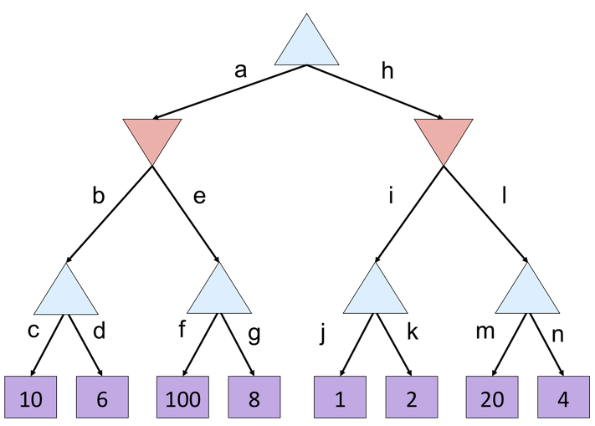
Minimax Quiz
What is the value of the top node?
A) 10
B) 100
C) 2
D) 4

Slide 70
Alpha Beta Quiz
Which branches are pruned?
A) e, l
B) g, l
C) g, k, l
D) g, n

Slide 71
Alpha-Beta Quiz 2
α =
10
?
β =
10
β =
2
?
?
1
2
v=
α=
10
α=
100
?
?
?

Slide 72
Alpha-Beta Pruning Properties
Theorem: This pruning has no effect on minimax value computed for the root!
Good child ordering improves effectiveness of pruning
Iterative deepening helps with this
With “perfect ordering”:
Time complexity drops to O(b^{m/2})
Doubles solvable depth!
1M nodes/move => depth=8, respectable
This is a simple example of metareasoning (computing about what to compute)
max
min
10
10
0

Slide 73
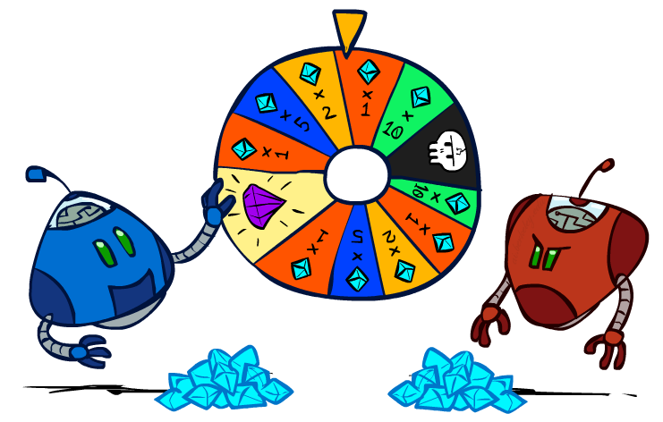
Games with uncertain outcomes
Notes:
Please retain proper attribution and the reference to ai.berkeley.edu. Thanks!

Slide 74
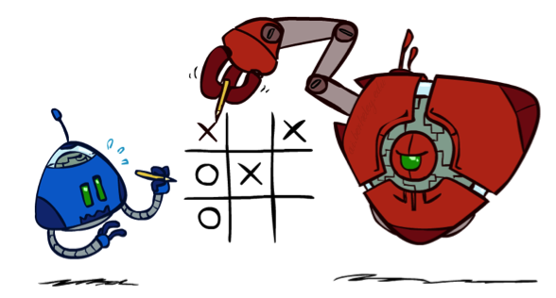
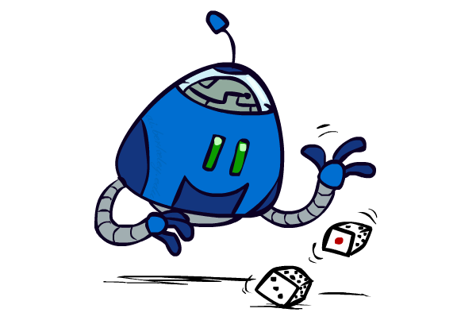

Chance outcomes in trees
10
10
9
100
10
10
9
100
Tictactoe, chess
Minimax
Tetris, investing
Expectimax
10
9
10
9
10
100
Backgammon, Monopoly
Expectiminimax
Notes:
At least 10, or otherwise just rather dead; or just 100, or otherwise rather dead; that’s yet something different than minimax or expectimax

Slide 75
Minimax
function decision(s) returns an action
return the action a in Actions(s) with the highest value(Result(s,a))
function value(s) returns a value
if Terminal-Test(s) then return Utility(s)
if Player(s) = MAX then return max_{a in Actions(s)} value(Result(s,a))
if Player(s) = MIN then return min_{a in Actions(s)} value(Result(s,a))
Notes:
Note that “minimax-decision” has become just “decision”

Slide 76
Expectiminimax
function decision(s) returns an action
return the action a in Actions(s) with the highest value(Result(s,a))
function value(s) returns a value
if Terminal-Test(s) then return Utility(s)
if Player(s) = MAX then return max_{a in Actions(s)} value(Result(s,a))
if Player(s) = MIN then return min_{a in Actions(s)} value(Result(s,a))
if Player(s) = CHANCE then return sum_{a in Actions(s)} Pr(a) * value(Result(s,a))
Notes:
Note that “minimax-decision” has become just “decision”

Slide 77
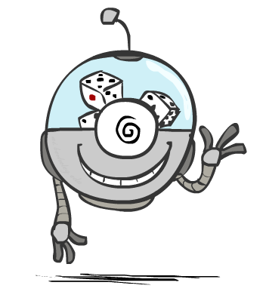
Probabilities

Slide 78
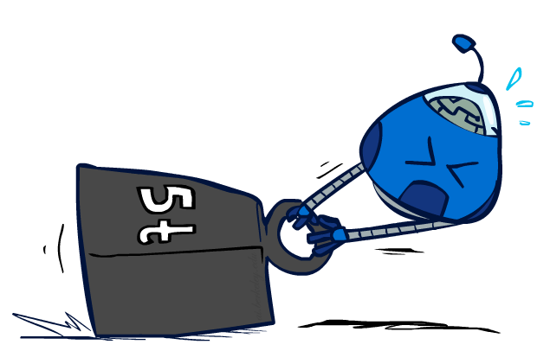
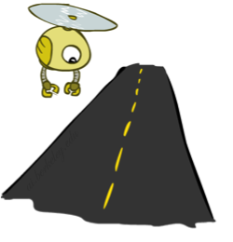
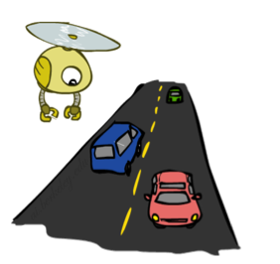
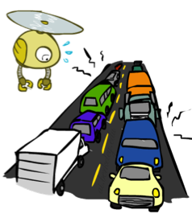
Reminder: Expectations
The expected value of a random variable is the average, weighted by the probability distribution over outcomes
Example: How long to get to the airport?
Time:
20 min
30 min
60 min
+
+
35 min
x
x
x
Probability:
0.25
0.50
0.25

Slide 79
Expectimax Pseudocode
sum_{a in Action(s)} Pr(a) * value(Result(s,a))
1/2
1/6
1/3
5
8
7
24
-12
v = (1/2) (8) + (1/3) (24) + (1/6) (-12) = 10

Slide 80
Expectimax Example
3
12
9
2
4
6
15
6
0

Slide 81
What Values to Use?
0
40
20
30
x²
0
1600
400
900
x>y => f(x)>f(y)
f(x) = Ax+B where A>0
For worst-case minimax reasoning, evaluation function scale doesn’t matter
We just want better states to have higher evaluations (get the ordering right)
Minimax decisions are invariant with respect to monotonic transformations on values
Expectiminimax decisions are invariant with respect to positive affine transformations
Expectiminimax evaluation functions have to be aligned with actual win probabilities!

Slide 82
Summary
Multi-agent problems can require more space or deeper trees to search
Games require decisions when optimality is impossible
Bounded-depth search and approximate evaluation functions
Games force efficient use of computation
Alpha-beta pruning
Game playing has produced important research ideas
Reinforcement learning (checkers)
Iterative deepening (chess)
Rational metareasoning (Othello)
Monte Carlo tree search (Go)
Solution methods for partial-information games in economics (poker)
Video games present much greater challenges – lots to do!
b = 10⁵⁰⁰, |S| = 10⁴⁰⁰⁰, m = 10,000

